Slide 1
Character cauda-epid
Mackenzie
Department of Bio

Slide 2
ization of male mouse idymal α-L-fucosidase
J. Bartlett, Som Phopin, Barry Bean
logy, Lehigh University, Bethlehem PA 18015

Slide 3
Background
Semen specific α-L fucosidase forms in rats, Unio elongatulus, bulls, and humans (3)(4)(5)(6)
Carbohydrate involvement in sperm-egg interaction(1)
Fucose-binding protein a potential receptor on sperm membrane(2)
α-L fucosidase mediated fertilization in Halocynthia roretzi (7)
Majority α-L fucosidase in human seminal plasma(8)
Capacitated sperm immunolocalize strongly at anterior head, faintly at midpiece and some tails(9)
Acrosome-reacted sperm label in equatorial region(9)

Slide 4
Abstract
Characterization of the α-L-fucosidase enzyme in male mice was performed on cauda epididymal contents(CEC), containing mature sperm and caudal fluid. The enzyme has been implicated as playing a central role in fertilization. To fully understand the role of α-L-fucosidase, we have decided to employ a mouse model. The mouse model will allow us to carry out experiments not possible in humans. Here we report on the distribution, subcellular crypticity, and inhibition profiles with two different inhibitors. Information on the inhibitors’ action will allow us to make comparable observations about the effects of these on fertilization. Most α-L-fucosidase activity is found in the CEC supernatant. This source is shown to be significantly inhibited by both 18a and DFJ inhibitors. A large amount of cryptic α-L-fucosidase activity is released to the supernatant after capacitation. Permeabilization with Triton-X also shows crypticity of uncapacitated and capacitated cells. Ultimately, a characterization of α-L-fucosidase will further our understanding of the molecular mechanisms involved in mammalian fertilization.

Slide 5
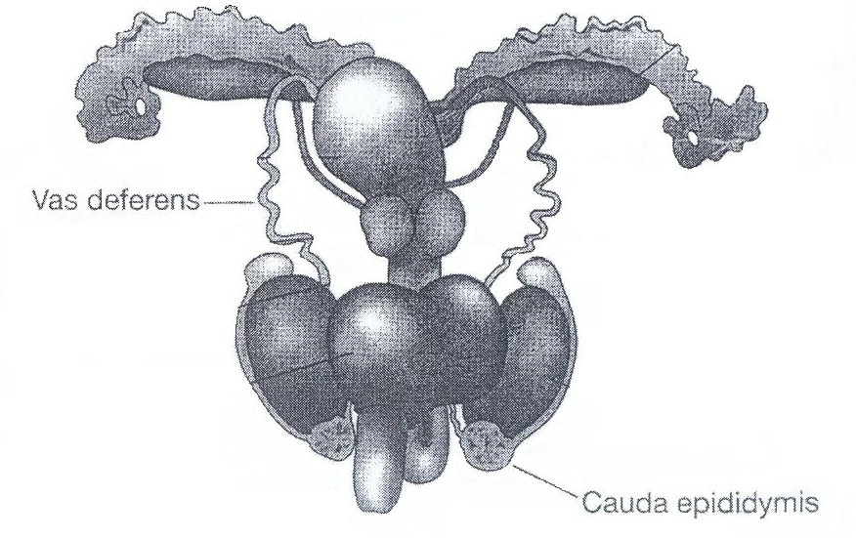
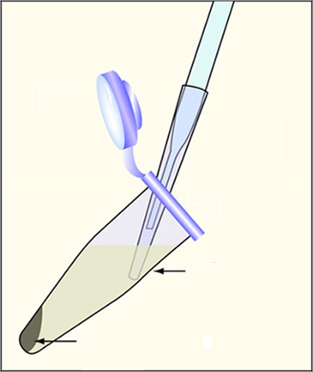
Experimental Procedure
Postmortem retrieval cauda epididymis and vas deferens
Incubate minced tissue at 37˚C, 5% CO₂ in 1ml HSM to release CEC
Centrifuge CEC at 500 X g, and remove supernatant
Wash cells twice and resuspend in HSM= uncapacitated cells
Supernatant
Sperm Cell Pellet
http://ocw.mit.edu/NR/rdonlyres/Biological-Engineering/20-109Fall-2007/A085142C-2DB3-41EA-B05A-2DC613F0AD9A/0/removing_cells.jpg
http://evolution.knu.ac.kr/en/contents/upload/001-male.jpg

Slide 6
α-L-fucosidase Enzyme Assay with Fluorogenic Substrate
-Mix substrate 4-Mu-FUC with HSM
-Add sample at time 0, measure fluorescence over time
-Data are expressed as enzyme activity (slope of fluorescence over time)
As a % of the control, or untreated sample
4-Mu - Fucose α-L-Fucosidase
Fucose + 4-Mu

Slide 7
Results
*
*
Fig 1: This graph shows enzyme distribution in CEC. Cell loss during washing stages is responsible for the loss of activity from CEC to Supernatant + Uncapacitated Pellet. P values for supernatant and uncapacitated pellet are 0.0194 and 0.0001 respectively over 5 replicates.

Slide 8
Inhibition
Treat supernatant for 10 minutes with concentrations of DFJ or 18a
*
*
*
*
*
*
Fig 2: This figure compares the inhibition of enzyme activity in mouse CEC supernatant with concentrations of treatment with 18a and DFJ. Both inhibitors show significant inhibition. P values are <0.01 for significant values, over 3-6 replicates
*DFJ inhibits Human seminal α-L-fucosidase. Preliminary data suggests that 18a also inhibits Human seminal α-L-fucosidase. Inhibitor 18a was a gift from Dr. Inmaculada Robina.(10)

Slide 9
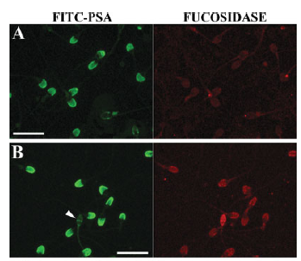
Capacitation
Treat uncapacitated cells with 1.5% BSA for 1 hour, 37˚C, 5% CO₂
*
*
A- Washed Uncapacitated cells
B- Capacitated cells
Fig 3: Cell suspensions show a significant increase in activity after capacitation of the uncapacitated pellet. The capacitated supernatant contains the majority of enzyme activity after capacitation. P values are 0.0034 and 0.0499 respectively over 11 replicates.
Image: Venditti et al. show the change in staining after sperm cell capacitation(9).

Slide 10
Permeabilization
Treat cells with various concentrations of Triton-X
*
*
*
Fig 4: Treatments with Triton-X show a decrease in activity at high concentrations. Uncapacitated cells show increased activity with 0.001% TX, whereas Capacitated cells show the most activity at 0.01% TX, with a small increase in activity at 0.001% TX. No significant change in enzyme activity is seen when supernatant is treated with TX(data not shown). P values are <0.05. Data is from >4 replicates.

Slide 11
Conclusions
~80% CEC α-L-fucosidase activity is in the soluble fraction. ~10% enzyme remains associated with the sperm cell.
Mouse supernatant α-L-fucosidase enzyme can be significantly inhibited by either 18a or DFJ inhibitors.
Capacitation shows crypticity- sperm contain more enzyme than is detectable in uncapacitated cells. Most is solubilized.
Permeabilization of uncapacitated and capacitated cells shows cryptic increase in enzyme activity.

Slide 12
Future Experiments
Determine enzyme localization after acrosome reaction.
Quantify α-L-fucosidase activity per sperm cell.
Characterize stability of α-L-fucosidase over time.
Stain mouse sperm cells at unwashed, capacitated, and acrosome reacted cells with anti-α-L-fucosidase antibodies.
Test effects of fluorous surfactants on enzyme activity of mouse sperm.
Characterize α-L-fucosidase in the female genital tract, uterus, and oocytes.

Slide 13
Acknowledgements
I’d like to thank Dr. Barry Bean, Som Phopin, Wutigri Nimlamool, Elijah Douglass, Nevada Heft and Jackie Taroni
References
Jauhiainen A and Vanha-Pertula T. 1986. α-L-Fucosidase in the preproductive organs and seminal plasma of the bull. Biochem Biophys Acta 880:91-95.
Focarelli R, Cacace MG, Serglia R, Rosati F. 1997. A nonglycosylated, 68-kDa α-L-fucosidase is bound to the mollusc bivalve Unio elongatulus sperm plasma membrane and differs from a glycosylated 56-kDa form present in the seminal fluid. Biochem Biophys Res Commun 234:54-58.
Avilés M, Abascal I, Martinez-Menarguez JA, Castells MT, Skalaban SR, Ballesta J, Alhadeff JA. 1996. Immunocytochemical localization and biochemical characterization of a novel plasma membrane-associated, neutral pH optimum α-L-fucosidase from rat testis and epididymal spermatozoa. Biochem J 318:821-831.
Alhadeff JA,Khunsook S, Choowongkomon K, Baney T, Heredia V, Tweedie A, Bean B. 1999. Characterization of human semen α-L-fucosidases. Mol Hum Reprod 5:809-815.
Benoff S. 1997. Carbohydrates and fertilization: An overview. Mol Hum Reprod 3:599-637.
Huang TTF, Ohzu E, Yanagimachi R. 1982. Evidence suggesting that L-Fucose is part of a recognition signal for sperm-zona pellucida attachment in mammals. Gamete Res 5:355-361.
Matsumoto M, Hirata J, Hirohashi N, Hoshi M. 2002. Sperm-egg binding mediated by sperm alpha-L-fucosidase in the ascidian Halocynthia roretzi. Zoolog Sci 19:43-48.
Khunsook S, Alhadeff JA, Bean BS. 2002. Purification and characterization of human seminal plasma α-L-fucosidase. Mol Hum Reprod 8:221-227.
Venditti JJ, Donigan KA, Bean BS. 2007. Crypticity and functional distribution of the membrane associated α-L-fucosidase of human sperm. Mol Reprod Devel 74:758-766.
Moreno-Clavijo E, Carmona AT, Vera-Ayoso Y, Moreno-Vargas AJ, Bello C,Vogel P, Robina I. 2009. Synthesis of novel pyrrolidine 3,4-diol derivatives as inhibitors of α-L-fucosidases. Org. Biomol. Chemistry, 7:1192-1202.

Slide 14
Other Data
Fig 5: Preliminary data showing that 18a works to inhibit seminal α-L-fucosidase in humans
Fig 6: Supernatant shows no significant difference in supernatant activity after treatment with Triton-x.

